Slide 1
JavaScript in APEX - Tips & tricks
Notes:
Ik ben de laatste vier jaar best veel met JavaScript bezig. Dat is deels zo gekomen door noodzaak in het project maar ook door persoonlijke interesse.
Het wil niet zeggen dat ik een JavaScript expert ben zoals een echte frontend developer, meer een fullstack APEX developer.
Ik geef vanavond een aantal tips maar blijf wel dichtbij APEX zelf.
In apex hebben wij niet veel te maken met vele JavaScript frameworks die wel uit de lucht lijken te vallen. Passen frameworks als Angular, React of Vue eigenlijk binnen APEX. Mijn antwoord zou zijn: over het algemeen niet. Wij hebben namelijk al een framework, en dat is Oracle APEX.
Die andere frameworks werken op een hele andere manier met HTML templates en databinding. Wij zijn vooral geinteresseerd in widgets zoals regions en items. Dat is een reden waarom Oracle Jet wel interessant is, daarin zijn vele componenten gemaakt als jQuery widgets. Alan heft deze week een plug-in gereleased en ik
Laatst horde ik dat het moeilijk is om mensen te vinden om een applicatie gemaakt met de eerste versie van Angular te beheren, die front-end developers willen met de nieuwste dingen bezig zijn en in tegenstelling tot APEX kun je niet zo makkelijk upgraden.

Slide 2
APEX has many features

Slide 3
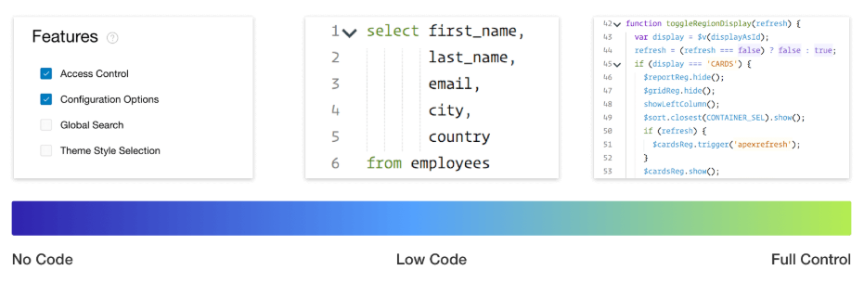

Slide 4
It’s a balance
Declarative features
Easy to learn

Slide 5
Non-declarative things
Adding checkboxes to a tree
Hiding the search field in the interactive Grid
Customize the rich text editor toolbar
Showing week numbers in the calendar
These are all widgets

Slide 6
How to choose JavaScript code
Declarative
APEX JS API
jQuery
Plain JS

Slide 7
Tips for working with widgets

Slide 8

The widget factory
Notes:
The widget factory gives you a blueprint to quickly build advanced components on your web page. All these items could have been build without the widget factory but using this proven tool has benefits. Make plug-ins in a standardized way. Developers know how to work with them and change them.

Slide 9
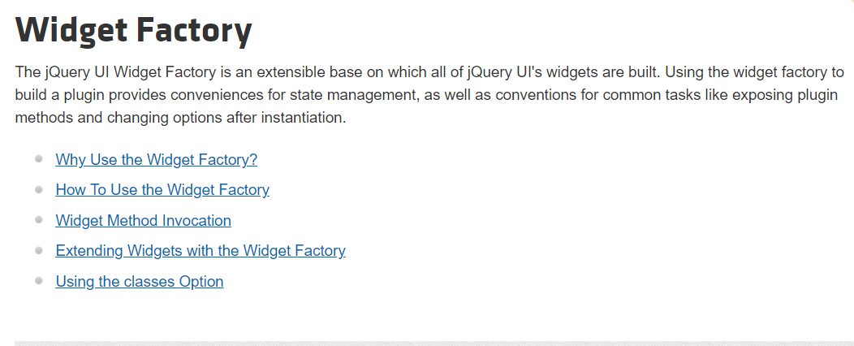
https://learn.jquery.com/jquery-ui/widget-factory/
Notes:
I would suggest to read that stuff. The way things work are explained very clearly there and it is not that much you need to know for the basics.

Slide 10
Getting all widget instances on a page
Widgets in jQuery UI have their own selectors. These selectors allow the developer to select widgets by type.
$(':<namespace>-<widget name>');
//Examples
$(':apex-interactivegrid');
$(':ui-datepicker');

Slide 11
Widgets are placed under a namespace
Namespace | Purpose | Widgets
$.ui | Native jQuery UI widgets | datepicker, dialog, …
$.apex | Oracle APEX Widgets | treeView, menu, interactiveGrid, …
$.fullCalendar | The calendar region widget | fullCalendar
$.oj | Oracle JET widgets | ojChart, ojGantt, …
$.demo | Our own widgets | none

Slide 12

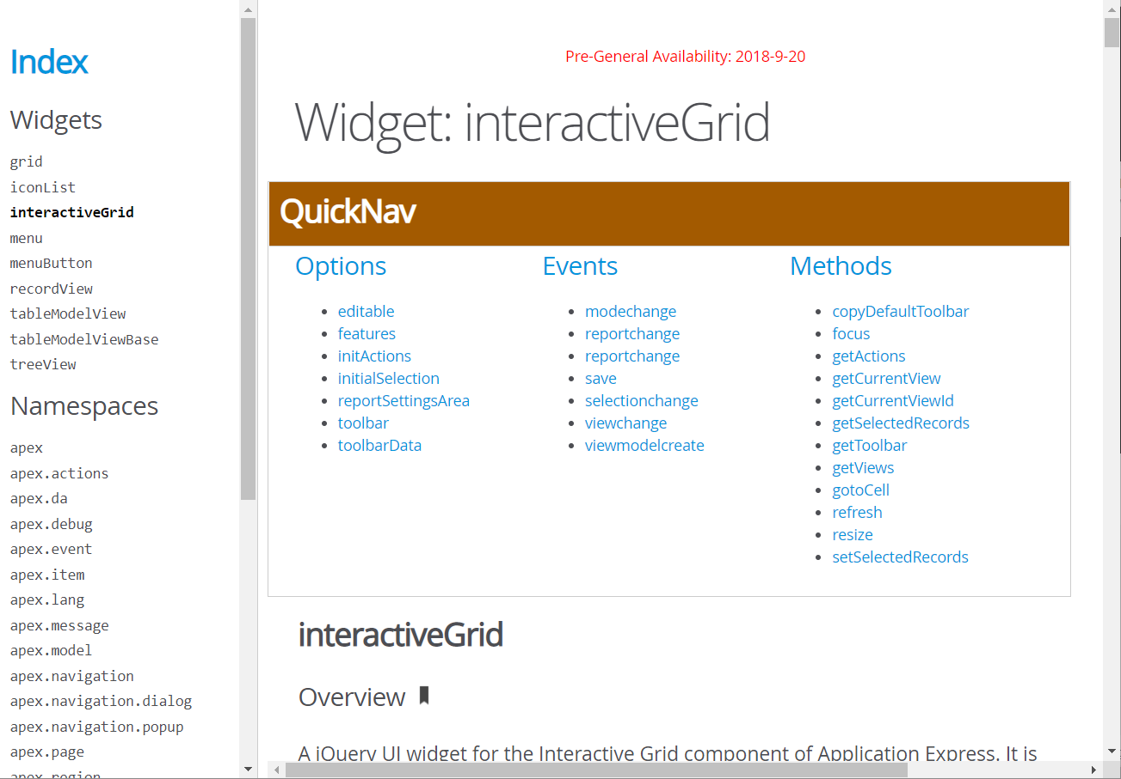

Slide 13
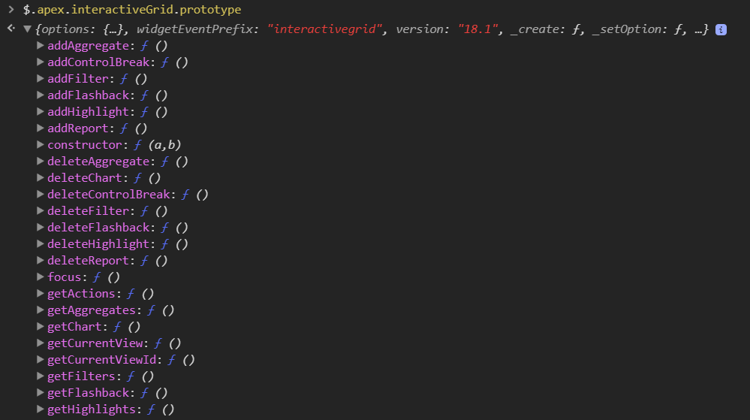
And has many public methods and functions
$.apex.interactiveGrid.prototype
Notes:
This is the result interactiveGrid widget, which is the starting point and is not yet documented.
This presentation is about plug-ins to I won’t go into details about how to use these methods. Other people have written about it.

Slide 14
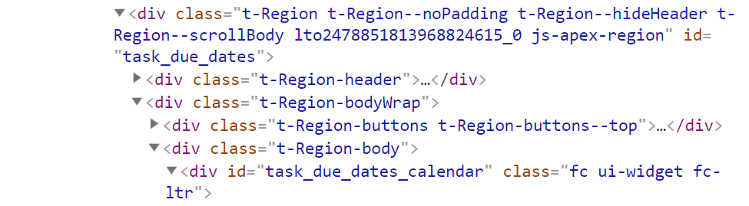
Using a region widget method
Region
let view = apex.region('task_due_dates').widget().fullCalendar('getView');
// or in 18.1 and onwards
let view = apex.region('task_due_dates').call('getView');
Widget
Notes:
We saw what happened on the client. Now lets look a the server side of things.
Three things have happened in APEX.
First, did we have a valid session? If not, redirect to a URL.
And when we landed on the login page, a new session was created for user “nobody”
User “nobody” is a special kind of user and we’ll find more about it soon.

Slide 15
Using a page item widget
$('#P1_DATE').datepicker('getDate');
// returns: Thu Jun 14 2018 00:00:00 GMT+0200 (Central Europe Daylight Time)
Notes:
We saw what happened on the client. Now lets look a the server side of things.
Three things have happened in APEX.
First, did we have a valid session? If not, redirect to a URL.
And when we landed on the login page, a new session was created for user “nobody”
User “nobody” is a special kind of user and we’ll find more about it soon.

Slide 16

When to use them
Changing options
Executing methods
Acting on events

Slide 17
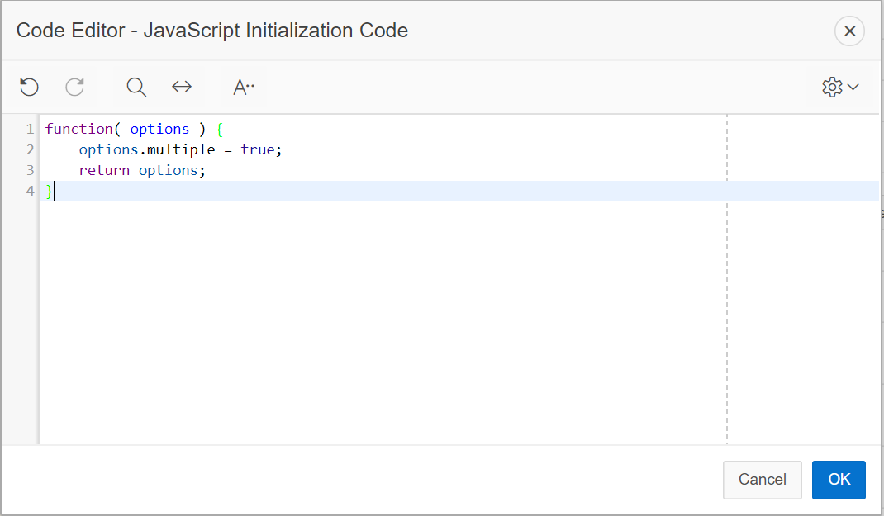
Changing widget options on initialization

Slide 18
Changing options
The options are part of the widget's state, so we can set options after initialization as well.
apex.region('mychart').call('option', 'orientation', 'horizontal');

Slide 19
Acting on events
Event names always start with the widget name in lowercase
All widgets have a create event
$('#emp').on('interactivegridcreate', function (event, data) {});
$('#emp').on('interactivegridselectionchange', function (event, data) {
console.log(data);
});
Notes:
We saw what happened on the client. Now lets look a the server side of things.
Three things have happened in APEX.
First, did we have a valid session? If not, redirect to a URL.
And when we landed on the login page, a new session was created for user “nobody”
User “nobody” is a special kind of user and we’ll find more about it soon.

Slide 20
Advanced usage
Extending a widget
$.widget('apex.interactiveGrid', $.apex.interactiveGrid, {
refresh: function () {
alert('Hello, I should refresh now..');
this._super();
}
});

Slide 21
Tips for working with events

Slide 22
Event capturing & bubbling
document
HTML
Event capturing
Event bubbling
body
region
button

Slide 23
Visualizing event listeners
A few options
Browser extension (Visual Event in Chrome)
Browser development tools

Slide 24
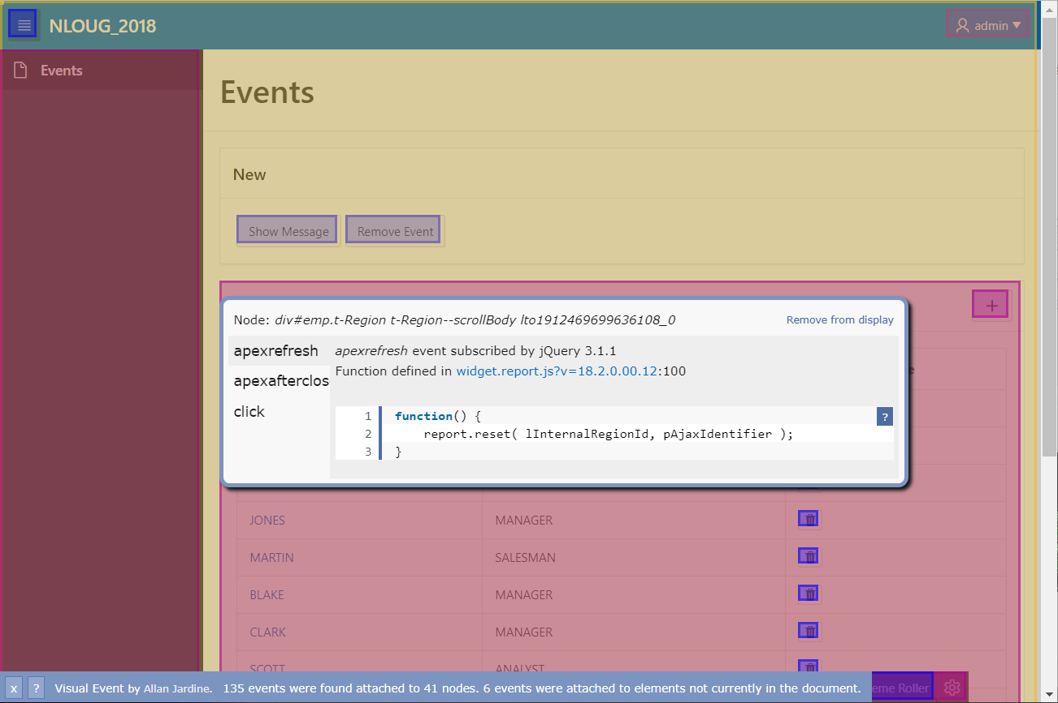

Slide 25
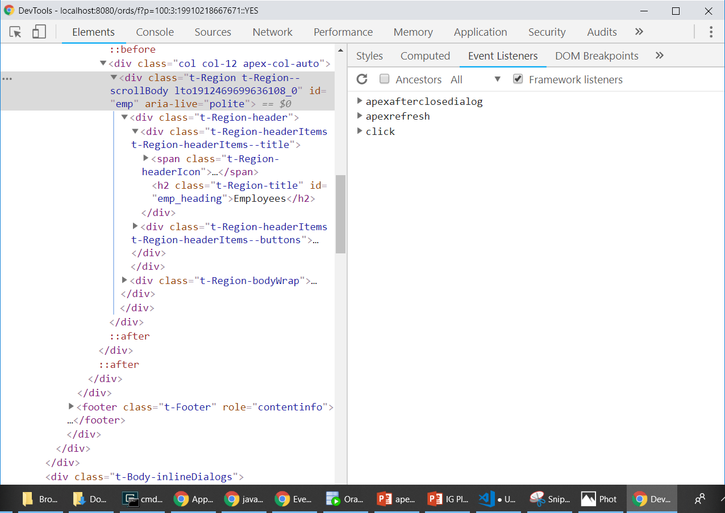

Slide 26
Tips for writing JavaScript

Slide 27
Using loops
var fruits = ['apple', 'banana', 'grape']
for (var i = 0; i < fruits.length; i++) {
console.log(fruits[i])
}
fruits.forEach(fruit => {
console.log(fruit)
})
for (const fruit of fruits) {
console.log(fruit)
}

Slide 28
Making arrays unique
var fruits = ['apple', 'banana', 'grape', 'grape']
var unique = fruits.filter(function(value, index, self) {
return self.indexOf(value) === index;
});
let unique = [...new Set(fruits)];

Slide 29
Using template literals
For adding variables to strings
var person = {
firstName: 'Larry',
lastName: 'Ellison'
}
console.log('Hi ' + person.firstName + ' ' + person.lastName)
console.log(`Hi ${person.firstName} ${person.lastName}`)
apex.util.applyTemplate('Hi &P1_FIRSTNAME. &P1_LASTNAME.')

Slide 30
If, else if..
Same for switch statement
function greet (jobName) {
var greeting = 'Hi'
if (jobName === 'CLERK') {
greeting = 'Yo'
} else if (jobName === 'MANAGER') {
greeting = 'Hello sir'
} else if (jobName === 'PRESIDENT') {
greeting = 'How do you do sir'
}
console.log(greeting)
}

Slide 31
If, else if..
Clean code
const greetings = {
CLERK: 'Yo',
MANAGER: 'Hello sir',
PRESIDENT: 'How do you do sir'
}
function greet (jobName) {
console.log(greetings[jobName] || 'Hi')
}

Slide 32
Using apex.server.process
Added in APEX 4.2 (Most common way)
apex.server.process("get_job", {
}, {
success: function (data) {},
error: function (err) {}
})

Slide 33
Using a promise
Simple and works in all supported browsers
apex.server
.process("get_job", {})
.then(response => {})
.catch(err => {})
Instead of callbacks

Slide 34

Refactor complex code
Makes it easier to read
Complex code
Simple code

Slide 35
Tips for structuring code in APEX

Slide 36
Production mode
APEX files
Custom files

Slide 37
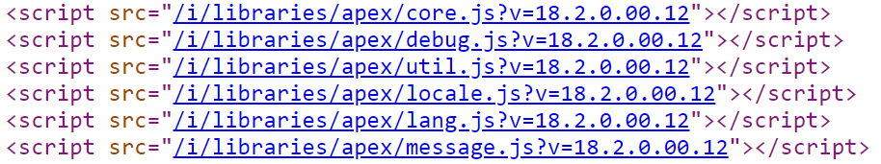
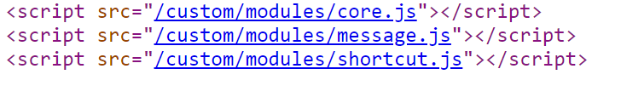
Debug mode
APEX files
Custom files

Slide 38


Style consistency
Format your code on file save

Slide 39
Place your code where it belongs
Database objects
PL/SQL
APEX
JavaScript
JavaScript files

Slide 40
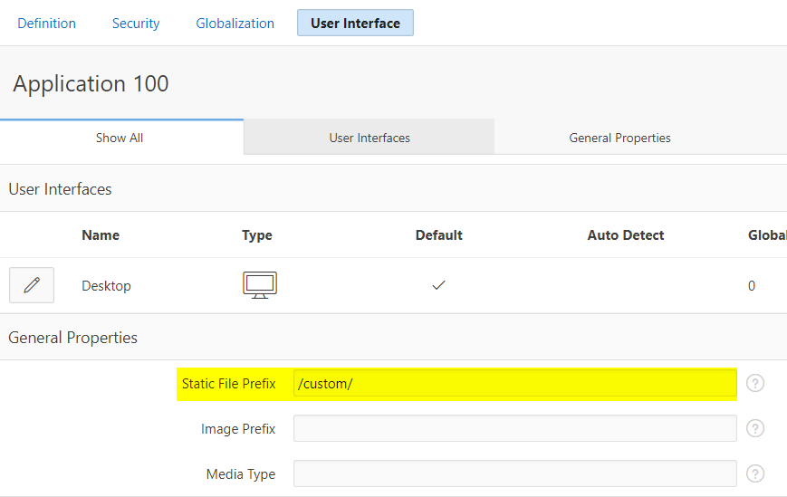
Avoid #IMAGE_PREFIX# as custom file location
#APP_IMAGES#

Slide 41
Configure extra document directory in HTTP server
Example for $CATALINA_BASE/conf/server.xml
<Host name="localhost" appBase="webapps"
unpackWARs="true" autoDeploy="true">
... <!-- A custom path to my files -->
<Context path="/custom" docBase="C:\git\nlOUG-Demo\dist" />
</Host>
As defined in APEX
Your custom directory

Slide 42
In a nutshell
JavaScript in files
Write simple code
DRY
Keep an eye on performance
Pick a coding standard
Keep learning

Slide 43
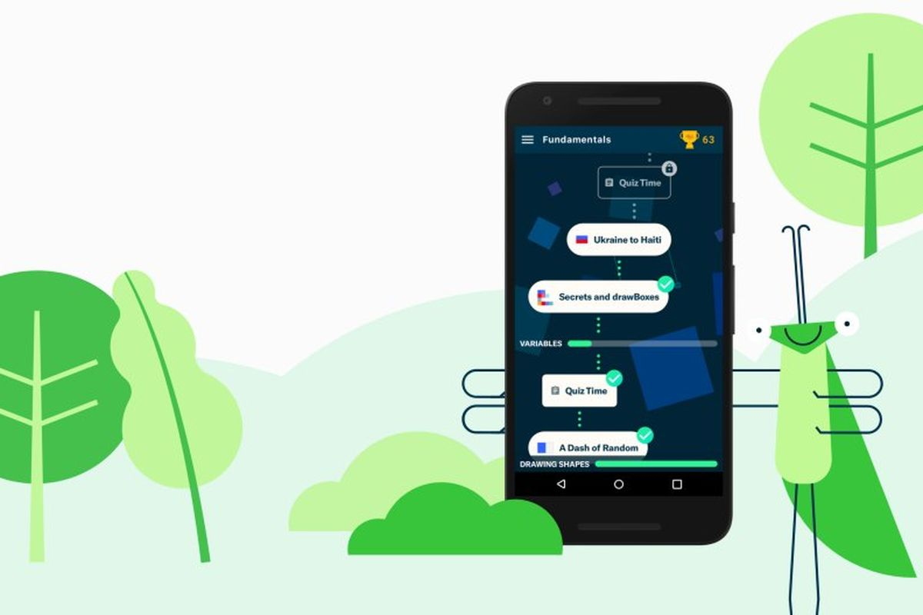
Want to learn more JavaScript in a fun way?
Try the free Grasshopper App
https://grasshopper.codes

Slide 44
Thank you

